Slide 1
Navajo Technical University Makerthon and the TCU Challenge
Students: Hansen Tapaha, Ericka Begody, Kirsh Davis, Nicklaus Begay
Professor: Dr. Peter Romine
Prepared: 4/22/2016

Slide 2
Navajo Technical University - NTUmakers
NTU is developing 5 projects
Medication Thermo-Cooler
PLENtu
Eyewriter
Rotorcraft Quadcopter
Robo-Digit
We plan to complete and bring projects 2,3,4,5 to the DC MakerFaire
Project 1 is our idea for the challenge.

Slide 3
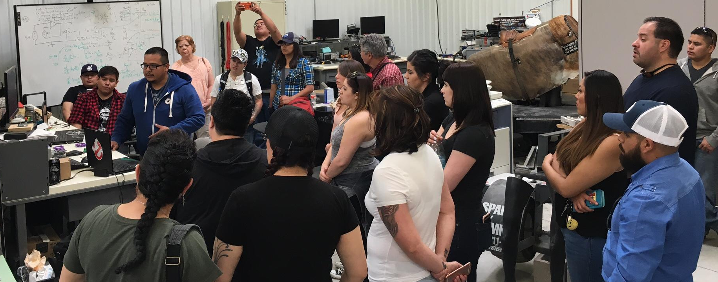
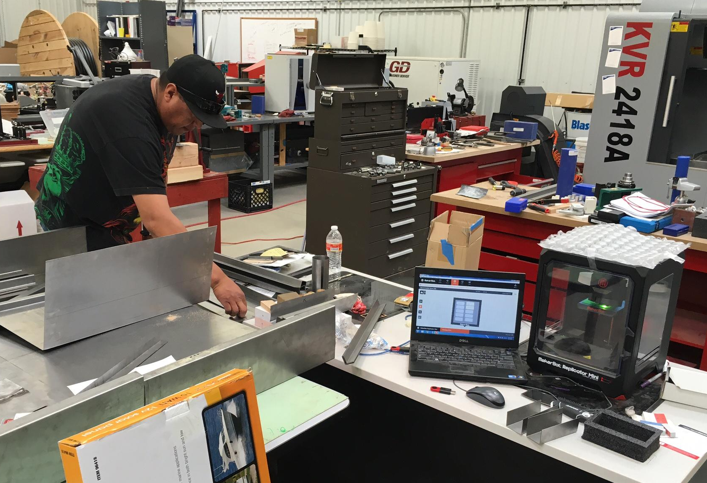
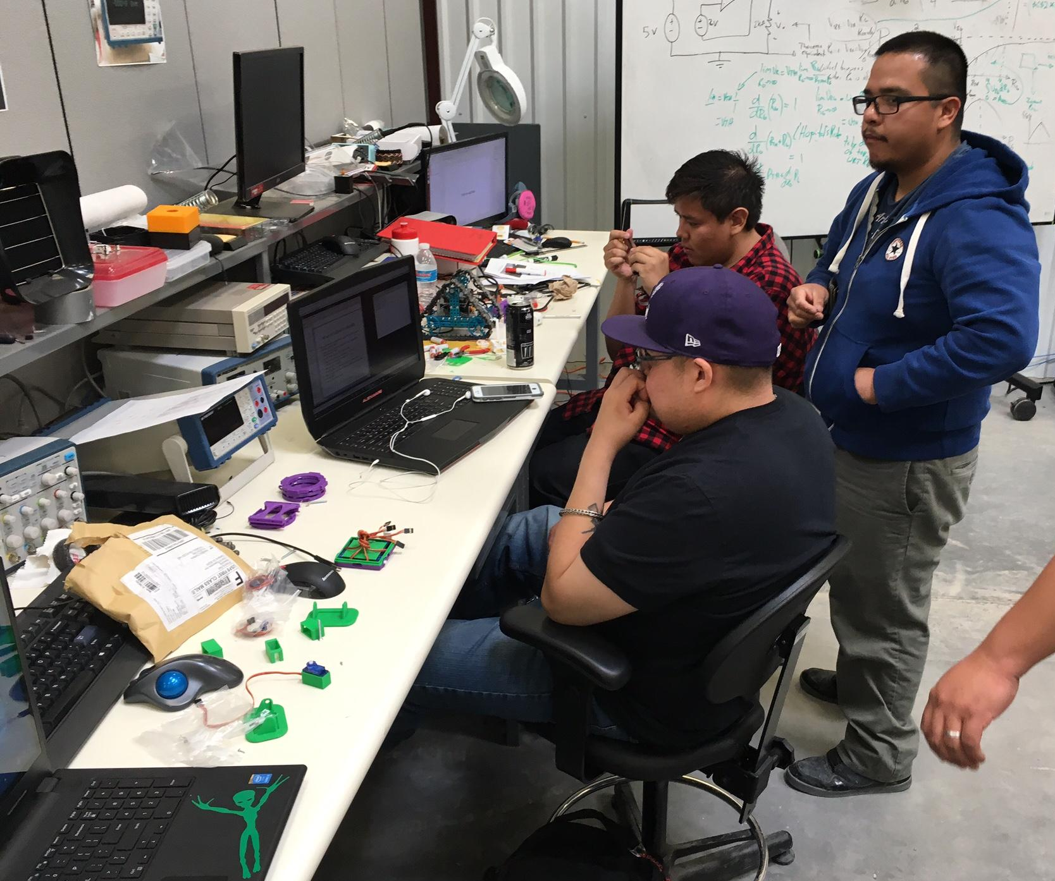
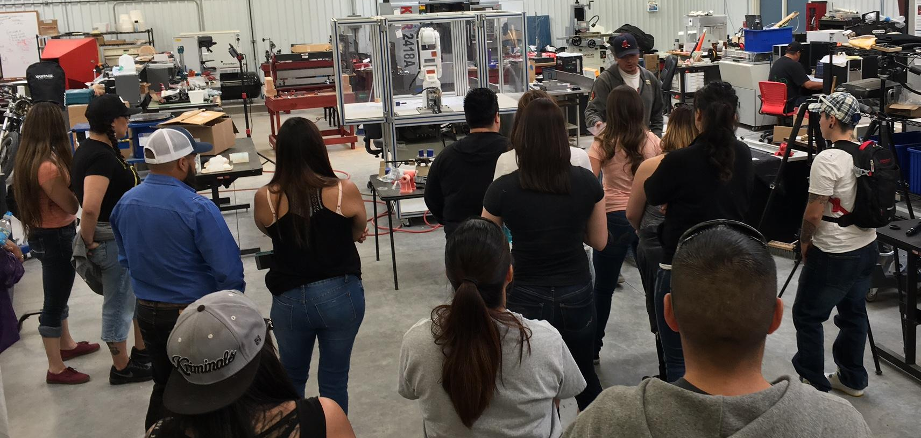
First Navajo Tech MakerThon – Thursday 4/21/2016 – FabLab MakerSpace – Crownpoint, NM

Slide 4
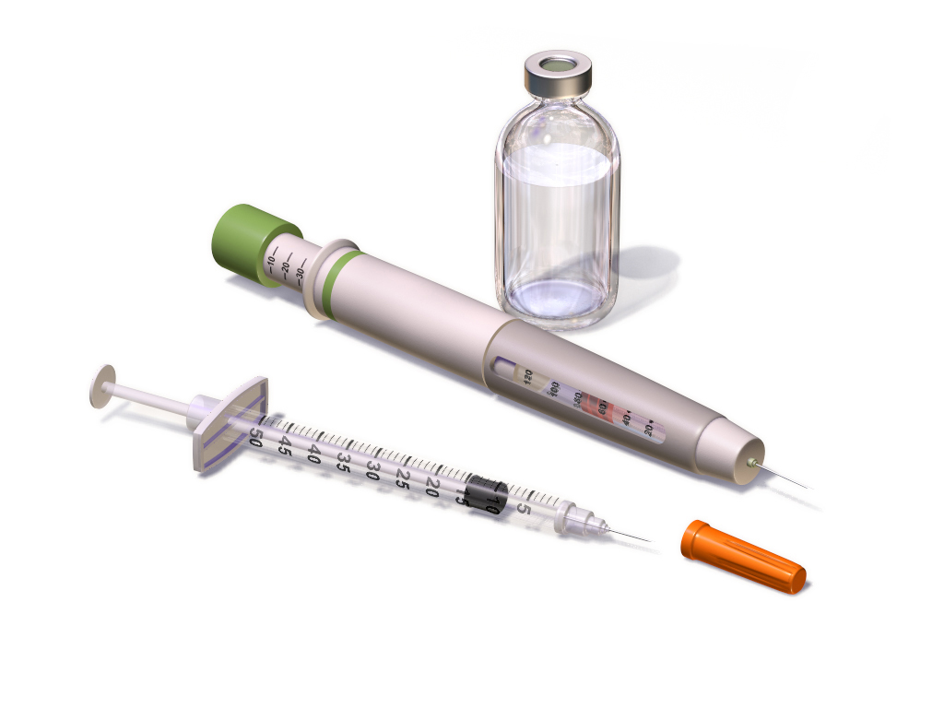
1 - Medication Thermo-Cooler
Many communities around the world (and on the Navajo Reservation) don’t have access to electricity.
We live in a society where many individuals suffer from medical conditions requiring heat sensitive medication(s).
The Medication Thermo-Cooler is constructed of
Insulated box and system that is built into a dwelling.
Thermo-electric and/or solar cooling system
Heat shield materials and Styrofoam.
Solar panels and sun collectors to power the cooling system.
Temperature monitor and control to maintain safe storage temperature.

Slide 5
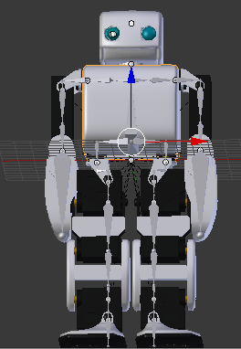
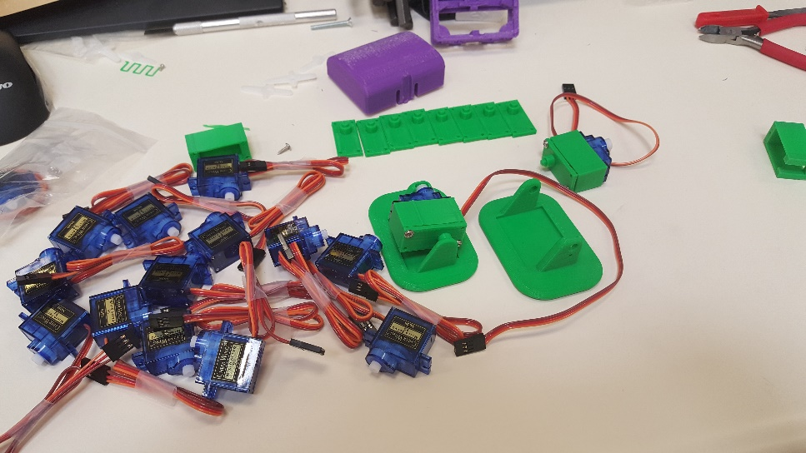
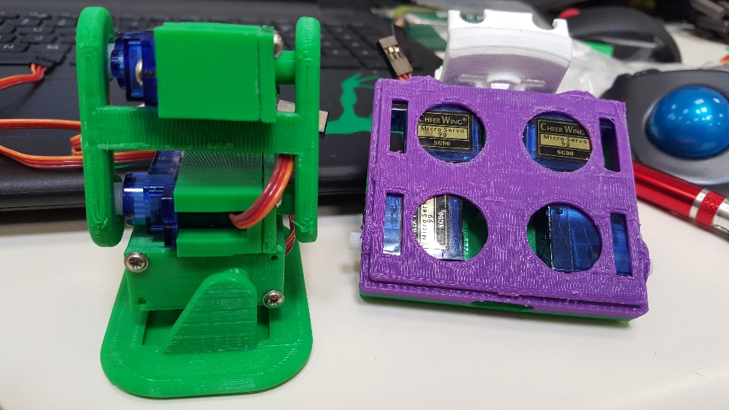
2 - PLENTU
PLENTU a different take on the open source project, PLEN2
16 servo motors, controlled through a 16-channel servo driver from an Arduino, also integrating 6 axis gyro and possibly Bluetooth capabilities in the future.
Designed with low cost in mind.
Uses in rehabilitation, as well as possible use in space exploration.
Learning kit could be used to instruct on programming, robotics, and hardware.

Slide 6
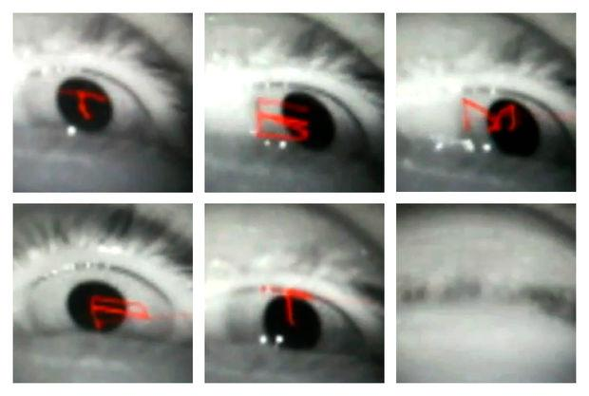
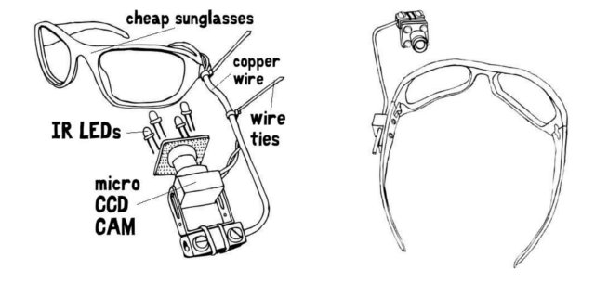
3 - Eyewriter
Nicholas J. Begaye
Student at Navajo Technical University
Majoring in Electrical Engineering & Mathematics
About
The eyewriter project was developed by a team of members from the Free Art and Technology (FAT), OpenFrameworks, the Graffiti Research Lab, and The Ebeling Group. A publisher and activist, named TemptOne was diagnosed with ALS in 2003, a disease which has left him almost completely physically paralyzed… except for his eyes. With an open source eye-tracking system it will allow ALS patients to draw using just their eyes.
Research & Modifications
In my research, I want to modify the eyewriter to where it does more than draw or write letters for artwork and have this type of device used for everyday use.

Slide 7
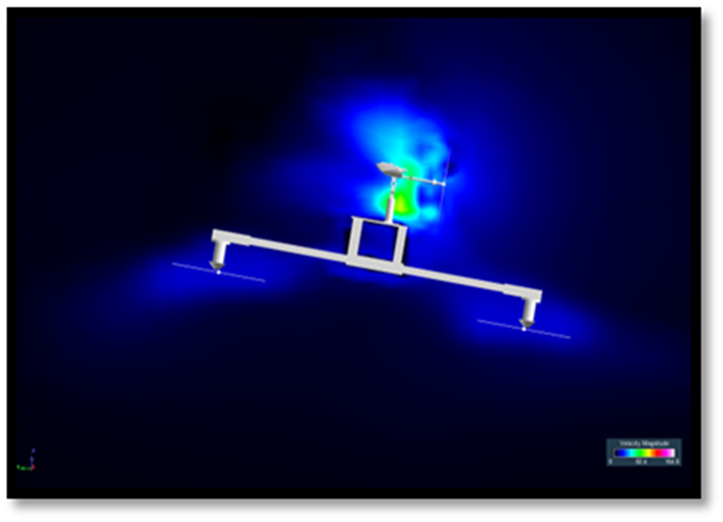
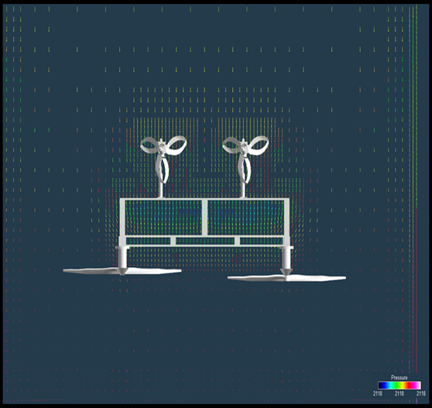
5 - Rotorcraft Quadcopter
Printable parts.
Fabrication from polyactic acid (PLA) filament will produce entire frame of quad-copter using a 3D Makerbot printer.
Printable parts will produce entire frame.
Rotor copter will be a autonomous UAV (unmanned aerial drone)

Slide 8
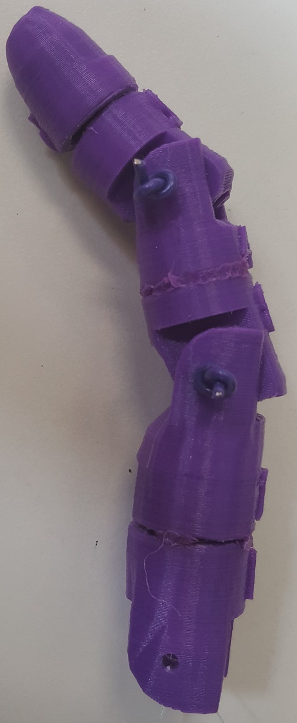
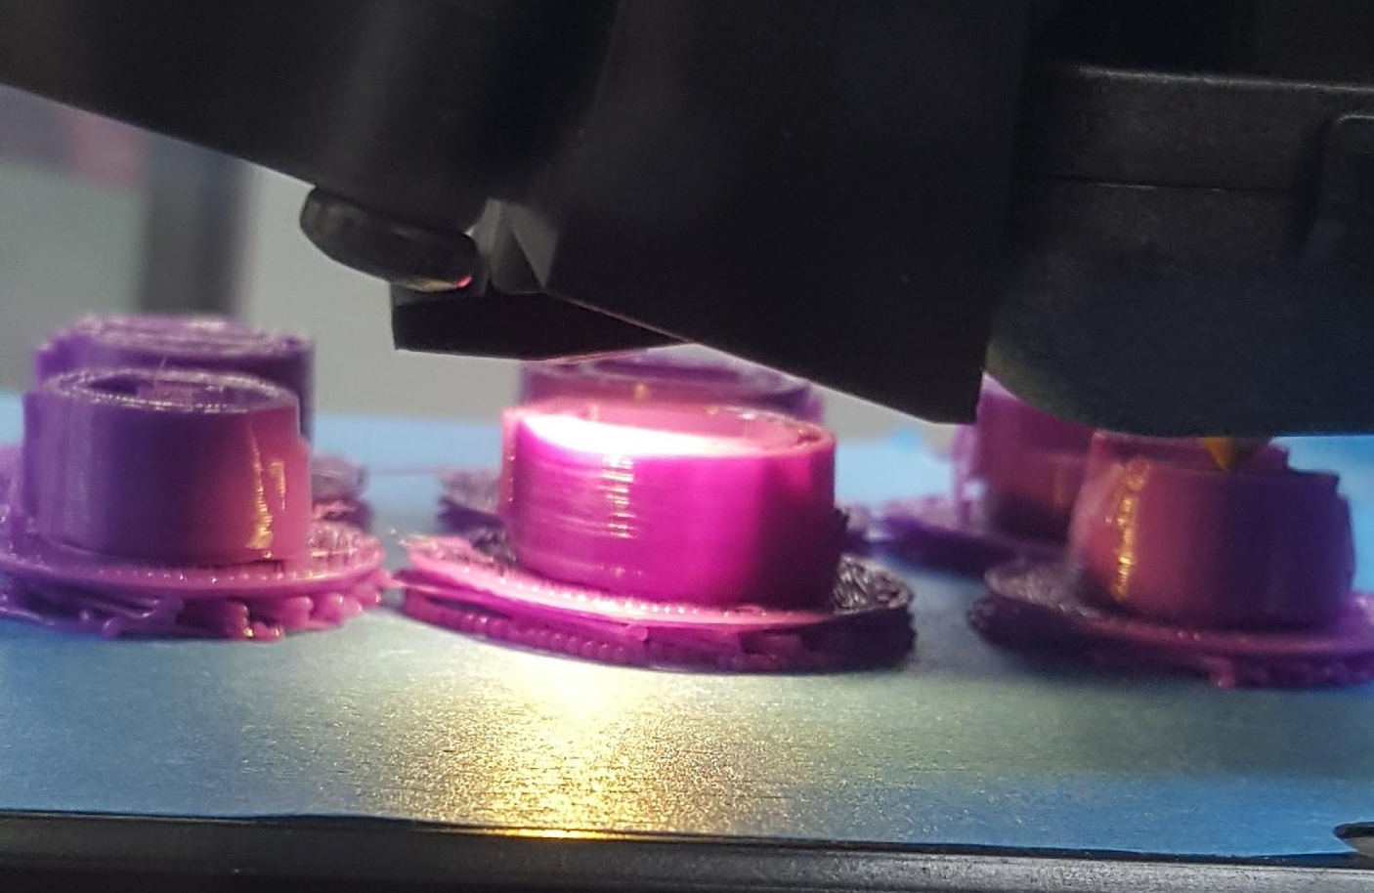
4 - Robo-digit
Diabetes is a common medical condition found on the
Navajo Reservation.
Uncontrolled diabetes can lead to amputations.
The purpose of this project is to provide low cost finger(s) prosthetics.
The Robo-digit is constructed of:
3-D printed finger
Servo motor
Arduino board

